Slide 1
An overview to JAVA Security libraries
By
MUHAMMAD HAMAD
GUL E FATIMA

Slide 2
Java Cryptography Architecture(JCA)
The Java platform strongly emphasizes security, including
cryptography
public key infrastructure
Authentication
Secure communication
The JCA is a major piece of the platform, and contains
a provider architecture
a set of APIs for
digital signatures
message digests (hashes)
certificates and certificate validation
encryption (symmetric/asymmetric , block/stream ciphers)
key generation and management
secure random number generation,

Slide 3

The Secure Random Class
Provides the functionality of a Random Number Generator (RNG).
It differs from the Random class in that it produces cryptographically strong random numbers.
If there is insufficient randomness in a generator, it makes it much easier to compromise your protection mechanisms

Slide 4
Use of Secure Random Class
To get random bytes, a caller simply passes an array of any length, which is then filled with random bytes
synchronized public void nextBytes(byte[] bytes)
it is possible to invoke the generateSeed method to generate a given number of seed bytes (to seed other random number generators)
byte[] generateSeed(int numBytes)
SecureRandom random;
random= SecureRandom.getInstance("SHA1PRNG", "SUN"); random.setSeed(userSeed);
keyGen.initialize(1024, random);

Slide 5

The Message Digest Class
The MessageDigest class is an engine class designed to provide the functionality of cryptographically secure message digests such as SHA-1 or MD5.
A cryptographically secure message digest takes arbitrary-sized input (a byte array), and generates a fixed-size output, called a digest or hash.

Slide 6
Use of Message Digest Class
MessageDigest sha = MessageDigest.getInstance("SHA-1");
Suppose we have two byte arrays, i1 and i2, which form the total input whose message digest we want to compute.
sha.update(i1);
sha.update(i2);
byte[] hash = sha.digest();

Slide 7
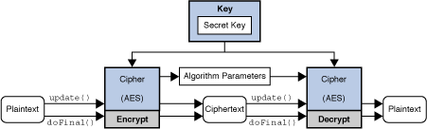
The Cipher Class
The Cipher class provides the functionality of a cryptographic cipher used for encryption and decryption.
Symmetric vs. Asymmetric Cryptography
Stream vs. Block Ciphers
Modes Of Operation

Slide 8
Use of Cipher Class
Here, the algorithm name is slightly different than with other engine classes, in that it specifies not just an algorithm name, but a "transformation".
A transformation is a string that describes the operation (or set of operations) to be performed on the given input to produce some output.
A transformation is of the form:
"algorithm/mode/padding" e.g. "DES/CBC/PKCS5Padding"
"algorithm“ e.g. "DES"

Slide 9
Cont’d
Cipher c1 = Cipher.getInstance("DES/ECB/PKCS5Padding"); Cipher c1 = Cipher.getInstance("DES"); c.init(Cipher.ENCRYPT_MODE, myKey);
byte[] cipherText = c.doFinal("example".getBytes());
Initializing a Cipher Object
ENCRYPT_MODE Encryption of data.
DECRYPT_MODE Decryption of data.
WRAP_MODE Wrapping a java.security.Key into bytes so that the key can be securely transported.
UNWRAP_MODE Unwrapping of a previously wrapped key into a java.security.Key object

Slide 10
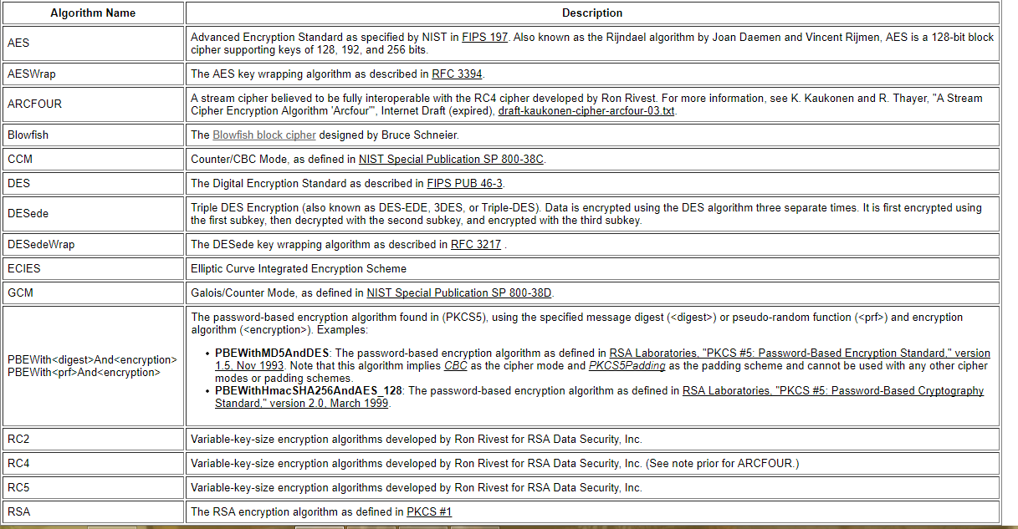
ALGORITHM NAMES

Slide 11
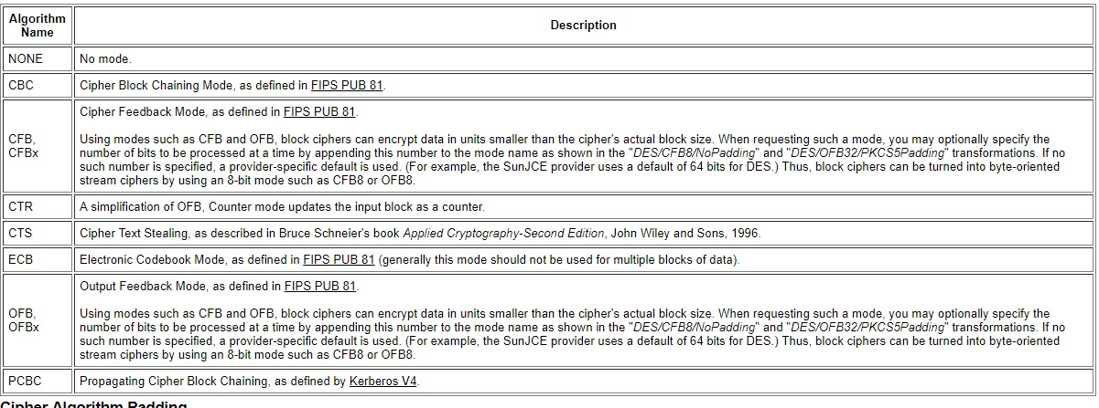
MODES

Slide 12
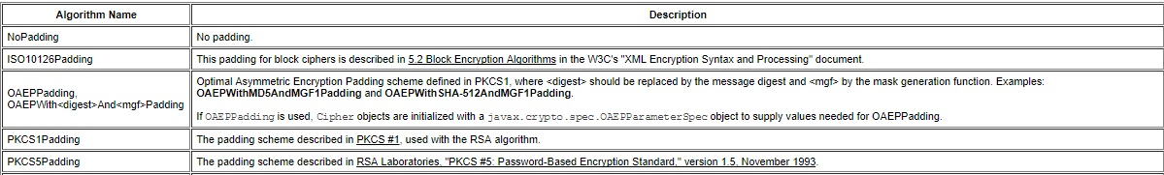
PADDINGS

Slide 13
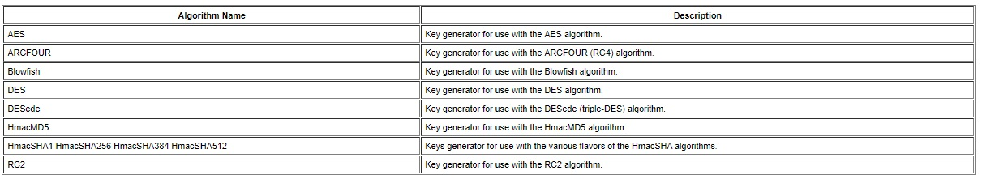
KEY GENERATORS

Slide 14
BLOWFISH IMPLEMENTED
public static void main(String[] args) {
// create a key generator based upon the Blowfish cipher
KeyGenerator keygenerator = KeyGenerator.getInstance("Blowfish"); // create a key
SecretKey secretkey = keygenerator.generateKey(); // create a cipher based upon Blowfish
Cipher cipher; = Cipher.getInstance("Blowfish"); // initialise cipher to with secret key
cipher.init(Cipher.ENCRYPT_MODE, secretkey); // get the text to encrypt
String inputText = JOptionPane.showInputDialog("Input your message: ");
byte[] encrypted = cipher.doFinal(inputText.getBytes()); // encrypt message
cipher.init(Cipher.DECRYPT_MODE, secretkey); // re-initialise the cipher to be in decrypt mode
byte[] decrypted = cipher.doFinal(encrypted); // decrypt message
JOptionPane.showMessageDialog(JOptionPane.getRootFrame(), "encrypted text: " + new String(encrypted) + "\n" +
"decrypted text: " + new String(decrypted));
}

Slide 15
AES IMPLEMENTED (ENCRYPT FUNCTION)
public static String encrypt(String key, String initVector, String value) {
try {
IvParameterSpec iv = new IvParameterSpec(initVector.getBytes("UTF-8"));
SecretKeySpec skeySpec = new SecretKeySpec(key.getBytes("UTF-8"), "AES");
Cipher cipher = Cipher.getInstance("AES/CBC/PKCS5PADDING");
cipher.init(Cipher.ENCRYPT_MODE, skeySpec, iv);
byte[] encrypted = cipher.doFinal(value.getBytes());
String encryptedValue = DatatypeConverter.printBase64Binary(encrypted);
String s = new String(encryptedValue);
System.out.println("encrypted string: "+ s);
return s;
} catch (Exception ex) {
ex.printStackTrace();
}
return null;
}

Slide 16
AES IMPLEMENTED (DECRYPT FUNCTION)
public static String decrypt(String key, String initVector, String encrypted) {
try {
IvParameterSpec iv = new IvParameterSpec(initVector.getBytes("UTF-8"));
SecretKeySpec skeySpec = new SecretKeySpec(key.getBytes("UTF-8"), "AES");
Cipher cipher = Cipher.getInstance("AES/CBC/PKCS5PADDING");
cipher.init(Cipher.DECRYPT_MODE, skeySpec, iv);
System.out.println("length : "+encrypted.length());
byte[] decordedValue = DatatypeConverter.parseBase64Binary(encrypted);
byte[] original = cipher.doFinal(decordedValue);
return new String(original);
} catch (Exception ex) {
ex.printStackTrace();
}
return null;
}

Slide 17
AES IMPLEMENTED (MAIN FUNCTION)
String key = "Bar12345Bar12345"; // 128 bit key
String initVector = "RandomInitVector"; // 16 bytes IV
System.out.println(decrypt(key, initVector,encrypt(key, initVector, "Hello World")));

Slide 18
References
http://docs.oracle.com/javase/7/docs/technotes/guides/security/StandardNames.html
http://docs.oracle.com/javase/7/docs/technotes/guides/security/crypto/CryptoSpec.html#SecureRandom
http://docs.oracle.com/javase/7/docs/technotes/guides/security/crypto/CryptoSpec.html
http://docs.oracle.com/javase/7/docs/technotes/guides/security/crypto/CryptoSpec.html#Cipher
http://www.embedded.com/design/configurable-systems/4024599/Encrypting-data-with-the-Blowfish-algorithm
http://slogix.in/how-to-encrypt-and-decrypt-data-using-blowfish-algorithm-in-java#Source-code

